Slide 1

DATA 445 Business Analysis with Excel
ASSIGNMENT 3
Group 5 Kristyll Avila, Andrew Da Costa, Binal Patel

Slide 2
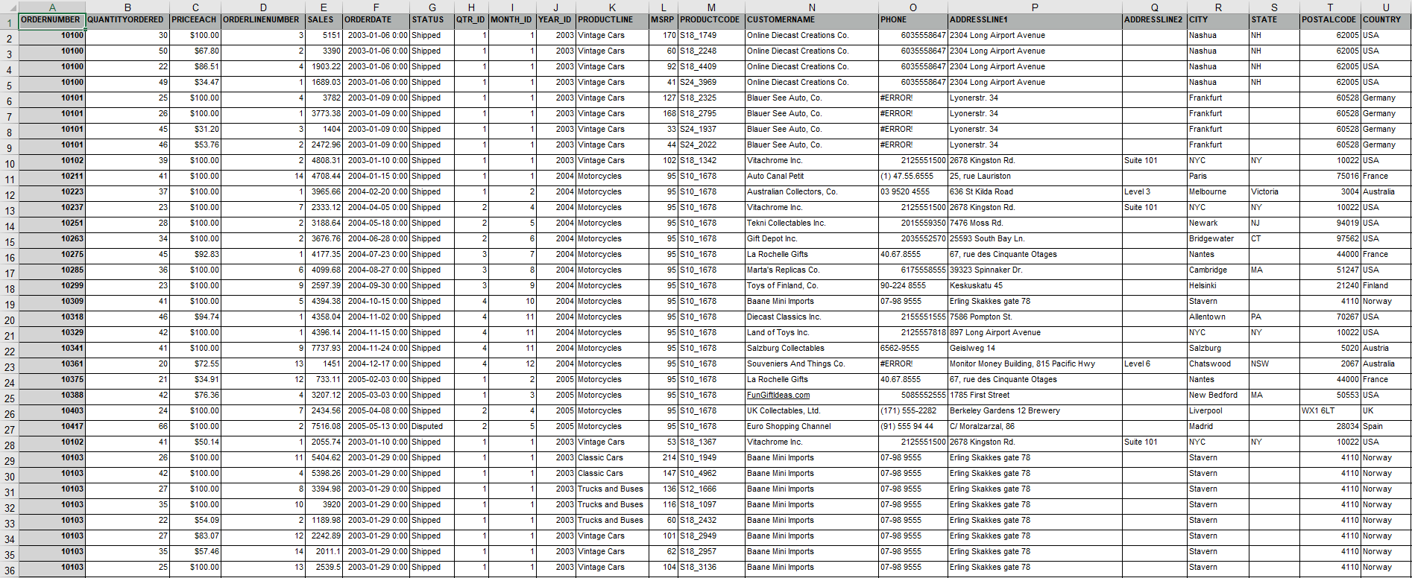
Dataset

Slide 3
Exploratory Data Analysis (EDA)

Slide 4
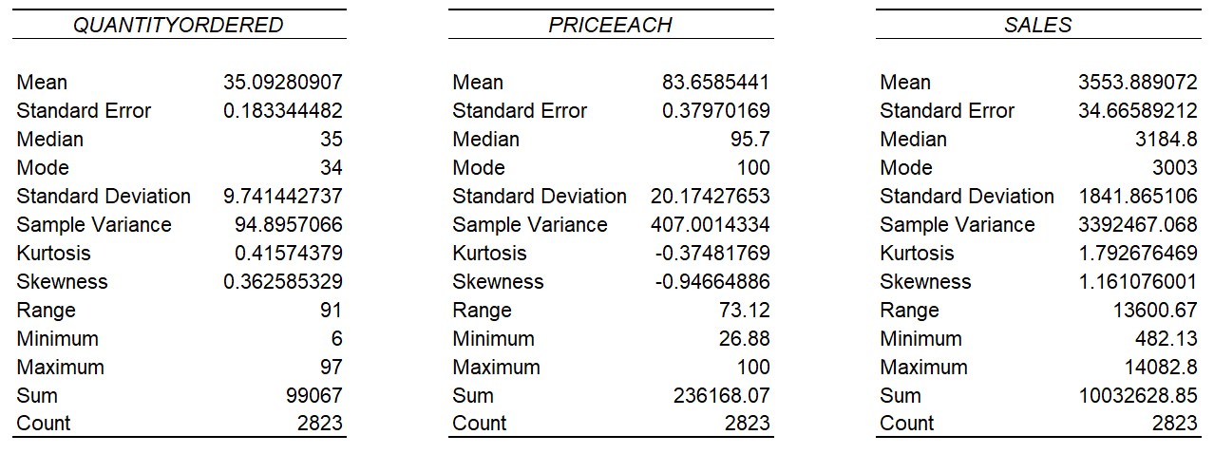
Exploratory Data Analysis (EDA)
Descriptive Statistics
Accuracy of distribution. The higher the SE the less reliable the data are.
Measure of dispersion.
A statistical measure of the peak of the curve for the given distribution.
A measure of the asymmetry of a distribution.
Notes:
The higher the SE the less reliable the data are.
The higher the Sample Variance the more spread out the data points are.
A positive kurtosis have higher peak than normal distribution and negative kurtosis have a lower peak than normal distribution.
A positive skew represents right skew where mean is greater than the median, while negative skew represents left skew where mean is less than the median.

Slide 5
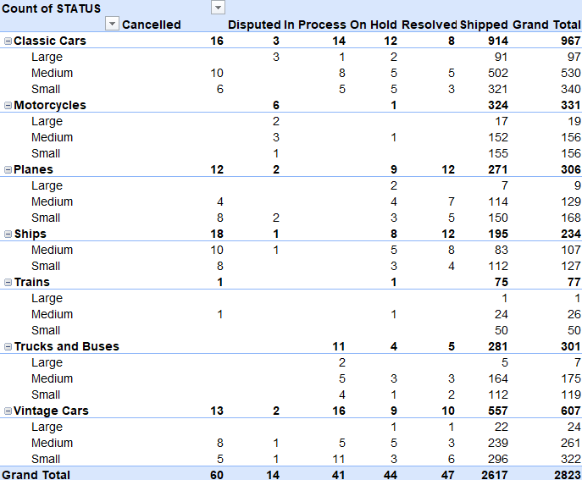
Exploratory Data Analysis (EDA)
Pivot Table

Slide 6
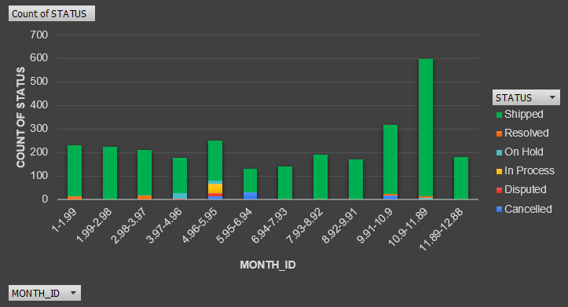
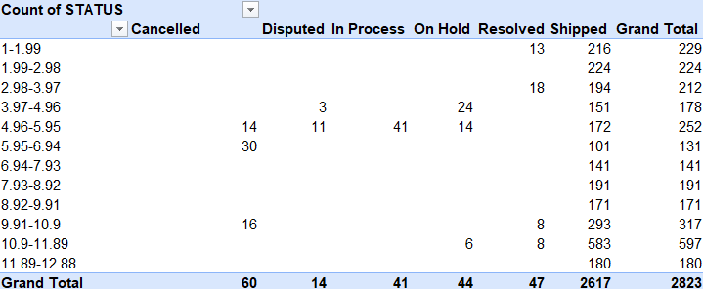
Exploratory Data Analysis (EDA)
Histogram

Slide 7
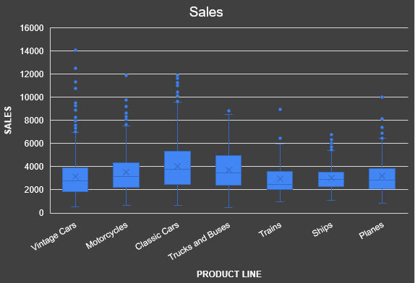
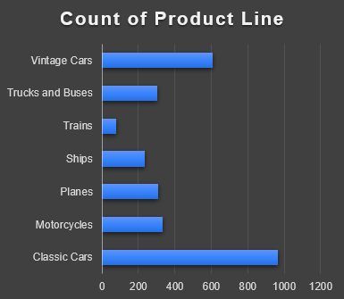
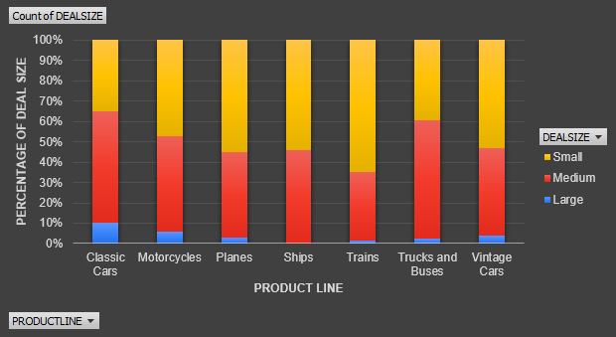
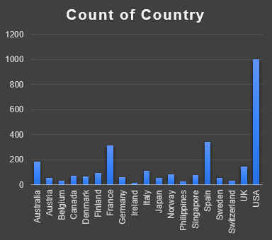
Exploratory Data Analysis (EDA)
More Visualization

Slide 8
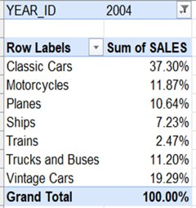
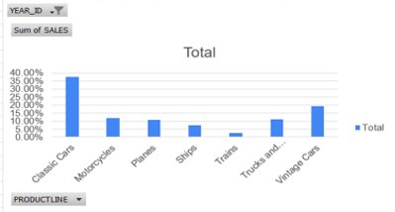
Exploratory Data Analysis (EDA)
Business Question
Question Which product line has maximum number of sales in year 2004?

Slide 9
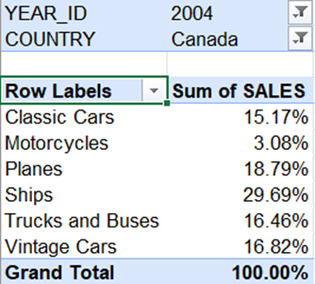
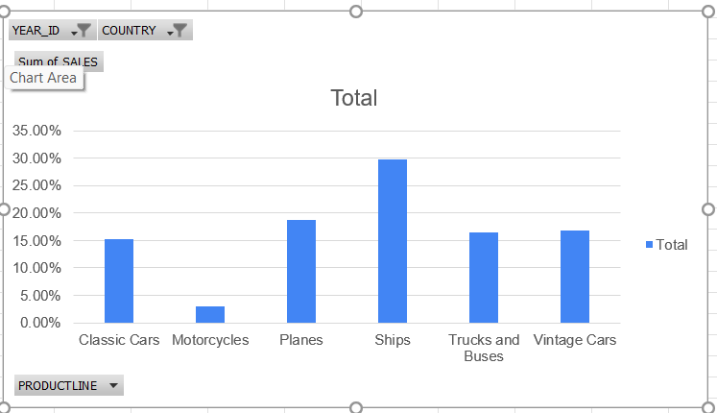
Exploratory Data Analysis (EDA)
Business Question
Sub Question In year 2004 which product line has more sales in Canada?

Slide 10
Predictive Analytics

Slide 11
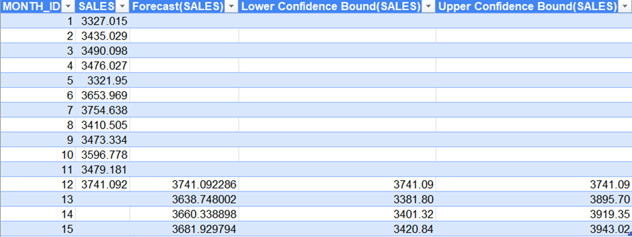
Predictive Analytics
Forecast Sheet
Question Using monthly sales average in year 2003, What is sales for next three months for 95% confidence?

Slide 12
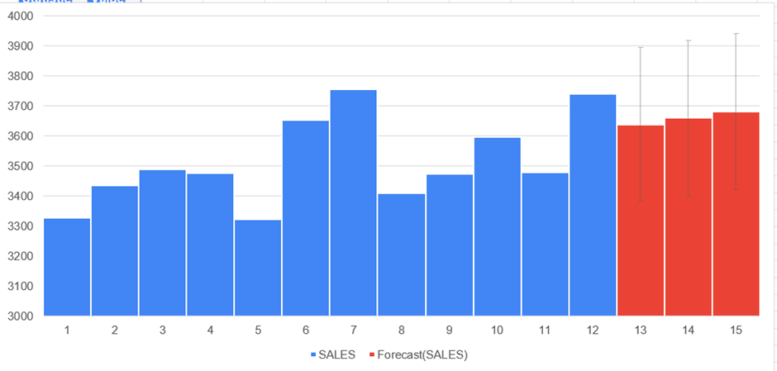
Predictive Analytics
Forecast Sheet

Slide 13
Predictive Analytics
Forecast Sheet
Timeline | Values | Forecast | Lower Confidence Bound | Upper Confidence Bound
1 | 41191.78
2 | 20464.41
3 | 105026.7
4 | 59873.6
5 | 98179.48
6 | 50256.79
7 | 94055.58
8 | 48406.61
9 | 137666.9
10 | 241145.4
11 | 452924.4
12 | 135593.7
13 | 122791.6
14 | 133034.8
15 | 81144
16 | 91815.89
17 | 83382.16
18 | 87163.19
19 | 151237.4
20 | 216895.8
21 | 97006.21
22 | 223856.8
23 | 372231.9
24 | 101697.4
25 | 139087.2
26 | 146148.6
27 | 91389.86
28 | 111562.5
29 | 184385.1 | 184385.11 | 184385.11 | 184385.11
30 |  | 162970.79 | -21916.52 | 347858.09
31 |  | 166251.45 | -24370.95 | 356873.84
32 |  | 169532.11 | -26701.62 | 365765.83
33 |  | 172812.77 | -28919.02 | 374544.56
34 |  | 176093.43 | -31032.34 | 383219.20
35 |  | 179374.09 | -33049.67 | 391797.86
36 |  | 182654.75 | -34978.18 | 400287.69
Question Using total monthly sales since the start of 2003 for Classic Cars, What would the monthly sales be by the end of 2005?

Slide 14
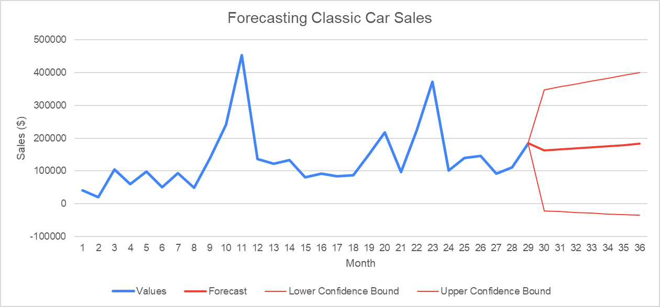
Predictive Analytics
Forecast Sheet

Slide 15
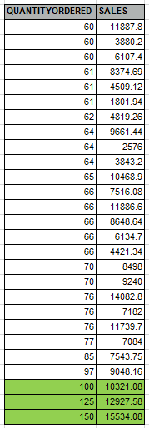
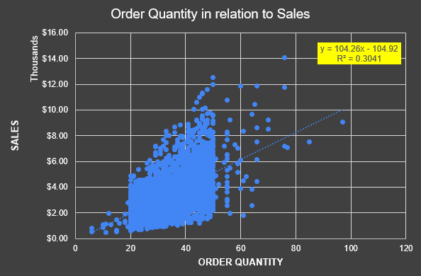
Predictive Analytics
Trendline
Notes:
A low R2 value represents a weak correlation.

Slide 16
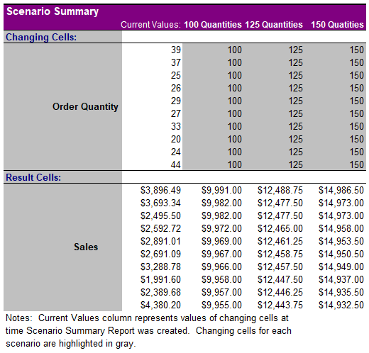
Predictive Analytics
Scenario Manager
Challenges and Observation
Assumption:
QuantityOrdered x PriceEach = Sales
When PriceEach equal to $100.00 the resulting Sales value differs
No meta data
Notes:
Next steps can include adding up the calculated predicted values to find the average sales which can make the predicted value more accurate and reliable.

